Slide 1
Introduction to OS
Lecture 1

Slide 2
Overview
Operating Systems basic concepts:
  What is OS?
  Brief History
    Motivation for OS
  Overview of Modern OSes
Operating System Structures
  OS components
  Types of kernel
Virtual Machines

Slide 3
What is OS?
Incorrect/Incomplete definition:
  It is the desktop when you boot up your PC
  The "thing" that stores your games
  Windows! (or Mac! ) (or Linux!)
One simple definition:
  A program that acts as an intermediary between a computer user and the computer hardware

Slide 4
Illustration: What is an OS?
User
Operating System
Hardware
A simplified view:
  Will be refined as we move along
The most general version:
  Hardware ( not only computer! )
  User ( can be application programs or actual person! )

Slide 5
Example of Common OS
On Computer:
  Windows 10/9/8/XP
  Mac OS X
  Linux distros: Ubuntu, Redhat, CentOS, Debian
  Solaris
On Smartphone:
  iOS, Android, Windows Mobile
Other hardware with OS:
  Game console: PS4, Xbox, Wii U, PSP vista, …
  Home appliance: Blueray/DVD Player, Mio TV console, …

Slide 6
brief history of OS
To invent the future, you must understand the past

Slide 7
Brief History of OS
Essentially, OS evolves with:
  Computer hardware
  User application and usage pattern
The "first" computers:
  Electronic Numerical Integrator And Computer (ENIAC)
    1945
    Program controlled by cables and switches
  Harvard Mark I:
    1944
    Program controlled by punched paper tape

Slide 8
OS for the first computers
OS Type:
  NO OS
User Program
Hardware
Programs directly interact with hardware
  Reprogram by changing physical configuration of hardware
Advantage:
  Minimal overhead
Disadvantage:
  Not portable
  Inefficient use of computer!

Slide 9
Mainframes: The "Big Iron"
Commonly used by large corporations in 60s, 70s
Common features:
  No interactive interface
  Accept programs in the form of:
    Paper tape, magnetic tape, punch card
  Support batch processing only
  Very costly
    Usually "rented" instead of owned
Example:
  IBM 360
    Cost 5 billion US dollar in 1964

Slide 10
OS for Mainframes
OS Type:
  Batch OS
User Program
OS
Hardware
Batch OS:
  Execute user program (a.k.a job) one at a time
    Load job from media, execute, collect result
User Job:
  Still interact with hardware directly
  With additional information for the OS
    Resource required
    Job specification

Slide 11
OS for Mainframes: Improvements
Simple batch processing is inefficient:
  CPU idle when perform I/O
One possible Improvements:
  Multiprogramming:
    loads multiple jobs and runs other jobs when I/O needs to be done
    Overlaps computation with I/O
Another development of OS during this period (70s):
  Time-Sharing OS

Slide 12
Time-Sharing OS
Features:
  Allow multiple users to interact with machine using terminals (teletypes)
  User job scheduling
    Illusion of Concurrency
  Memory management
Famous Examples:
  CTSS developed at MIT 1960s
  Multics (1970s)
    Considered as the parent of Unix
  Pushed the state of art in virtual memory, security
Not so different from using Unix servers today but more primitive

Slide 13
Time-sharing OS: Illustration
☺
☺
☺
Multiple Users
UP
UP
….
UP
Programs initiated by user
OS
Hardware
OS manages the sharing of:
  CPU time, memory and storage
Virtualization of hardware:
  Each program executes as if it has all the resources to itself

Slide 14
Minicomputer and Unix
Minicomputer follows the mainframe:
  A "mini" version of mainframe:
    Smaller and cheaper
  Example:
    Digital Equipment Corp (DEC) PDP-11
Famous OS:
  Unix
    Developed by AT&T employees, including Ken Thompson, Dennis Ritchie, Douglas McIlroy, and Joe Ossanna
    Ken Thompson and Dennis Ritchie
      Invented the C programming language as well!!

Slide 15
Personal Computer
Apple II PC:
  First successfully produced mass home computer
  Designed by Steve Wozniak (alone!)
IBM PC:
  The first generic PC
  PC becoming truly a collection of commodity hardware components
  Leads to dominance of Microsoft OS in PCs: MSDOS then Windows

Slide 16
OS on Personal Computer
Machine (can be) dedicated to user, not timeshared between multiple users
  Give rise to personal OS
Several Models:
  Windows model:
    Single user at a time but possibly more than 1 user can access
    Dedicated machine
  Unix model:
    One user at the workstation but other users can access remotely
    General time sharing model

Slide 17
Motivations of OS
Why do we need OS?

Slide 18
Motivation for OS: Abstraction
Large variation in hardware configurations
Example (Hard disk):
  Different capacity (500mb, 320gb, 1.5tb etc)
  Different capabilities:
    Rotation per minutes (RPM)
    Access (read/write) speed
    Etc
However, hardware in the same category has well defined and common functionality
  Example (Hard disk): Store and retrieve information

Slide 19
Motivation for OS: Abstraction
Operating System serves as an abstraction:
  Hide the different low level details
  Present the common high level functionality to user
The user can then perform essential tasks through operating system
  no need to concern with low level details
Provides:
  Efficiency and portability

Slide 20
Motivation for OS: Resource Allocator
Program execution requires multiple resources:
  CPU, memory, I/O devices etc
For better utilization of resources, multiple programs should be allowed to execute simultaneously
OS is a resource allocator
  Manages all resources
    CPU, Memory, Input/Output devices
  Arbitrate potentially conflicting requests
    for efficient and fair resource use

Slide 21
Motivation for OS: Control Program
Program can misuse the computer:
  Accidentally: due to coding bugs
  Maliciously: virus, malware etc
Multiple users can share the computer:
  Tricky to ensure separate user space
OS is a control program
  Controls execution of programs
    prevent errors and improper use of the computer
    Provides security and protection

Slide 22
Motivation for OS: Summary
Manage resources and coordination
  process synchronization, resource sharing
Simplify programming
  abstraction of hardware, convenient services
Enforce usage policies
Security and protection
User Program Portability:
  Across different hardware
Efficiency
  Sophisticated implementations
  Optimized for particular usage and hardware

Slide 23
Overview of Modern OS
The families of modern OS

Slide 24
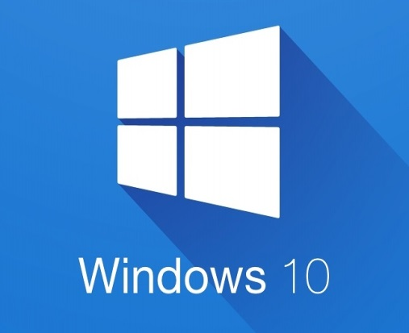
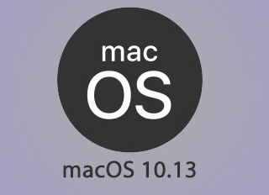
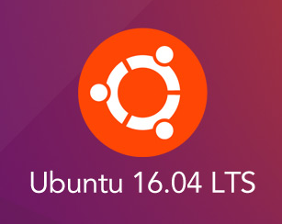
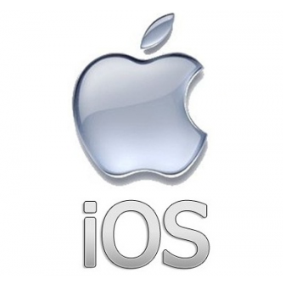
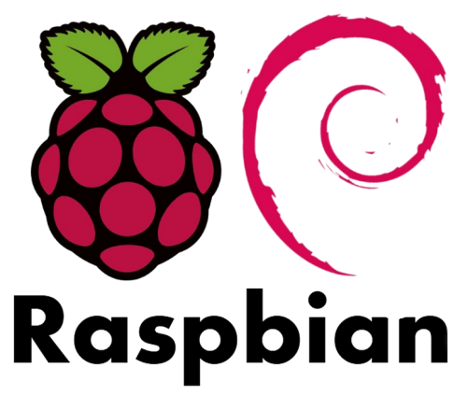
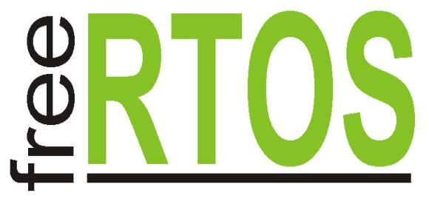
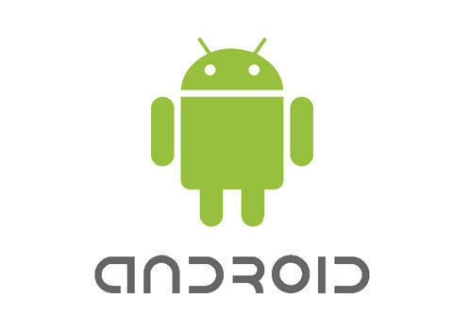
Modern OS: Overview
PC
Mobile
Real-Time
Embedded

Slide 25
OS Structure
Common Architecture for OS

Slide 26
Operating System Structures
We have identified the major capabilities of an OS
  i.e. the specification of the OS
Let us now consider:
  The best way to provides these capabilities
  i.e. the implementations of the OS
Operating system structure:
  Organization of the various components
  Important factors:
    Flexibility
    Robustness
    Maintainability

Slide 27
Illustration: High level view of OS
PowerPoint
Chrome
DOTA
User Mode
User Interface
Software
Kernel Mode
Operating System
Hardware
Hardware
Operating System is essentially a software
  Runs in kernel mode: Have complete access to all hardware resources
Other software executes in user mode
  With limited (or controlled) access to hardware resources

Slide 28
Illustration: Generic OS Components
System Processes
User Programs
E
D
Library
C
C
OS
A
B
B
Hardware
A: OS executing machine instructions
B: normal machine instructions executed (program/library code)
C: calling OS using system call interface
D: user program calls library code
E: system processes
  Provide high level services, usually part of OS

Slide 29
OS as a Program
OS is also known as the kernel
  Just another program with some special features
    Deals with hardware issues
    Provides system call interface
    Special code for interrupt handlers, device drivers
Kernel code has to be different than normal programs:
  no use of system call in kernel code
  can’t use normal libraries
  no normal I/O
Consider this:
  Normal programs use OS: what does OS use? ☺

Slide 30
Implementing Operating System
Programming Language:
  Historically in assembly/machine code
  Now in HLLs:
    Especially C/C++
  Heavily hardware architecture dependent
Common code organization:
  Machine independent HLL
  Machine dependent HLL
  Machine dependent assembly code
Challenges:
  “No one else” to rely on for nice services
  Debugging is hard
  Complexity
  Enourmous Codebase

Slide 31
OS Structures
Several ways to structure an OS:
  Monolithic
  Microkernel
  Layered
  Client-Server
  Exokernel
  etc
We will cover the first two in details:
  They represent the whole range of possibilities
  Most other approaches are variant or improvement

Slide 32
Monolithic OS
Kernel is:
  One BIG special program
    Various services and components are integral part
  Good SE principles is still possible with:
    modularization
    separation of interfaces and implementation
This is the traditional approach taken by:
  Most Unix variants, Windows NT/XP
Advantages:
  Well understood
  Good performance
Disadvantages:
  Highly coupled components
  Usually devolved into very complicated internal structure

Slide 33
Monolithic Kernel Illustration
User Programs
User Mode
System Call Interface
OS
Process Management
Memory Management
File System
Kernel Mode
Device Driver
Hardware
Generic Architecture of Monolithic OS Components

Slide 34
Microkernel OS
Kernel is:
  Very small and clean
  Only provides basic and essential facilities:
    Inter-Process Communication (IPC)
    Address space management
    Thread management
    etc
Higher level services:
  Built on top of the basic facilities
  Run as server process outside of the OS
  Use IPC to communicate
Advantages:
  Kernel is generally more robust and more extendible
  Better isolation and protection between kernel and high level services
Disadvantages:
  Lower Performance

Slide 35
Microkernel Components
User Programs
Device Driver
Process Management
Memory Management
File System
User Mode
OS
IPC
Scheduling
Interrupt Handler
…
Kernel Mode
Hardware
Generic Architecture of Microkernel OS Components

Slide 36
Other Operating System Structure
Layered Systems:
  Generalization of monolithic system
  Organize the components into hierarchy of layers
    Upper layers make use of the lower layers
    Lowest layer is the hardware
    Highest layer is the user interface
Client-Server Model
  Variation of microkernel
  Two classes of processes:
    Client process request service from server process
    Server Process built on top of the microkernel
    Client and Server process can be on separate machine!

Slide 37
Virtual Machines
Ways of running OSes

Slide 38
Motivation: Why Virtual Machines
Operating system assumes total control of the hardware:
  What if we want to run several OSes on the same hardware at the same time?
Operating system is hard to debug / monitor:
  How do we observe the working of the OS?
  How do we test a potentially destructive implementation?

Slide 39
Definition: Virtual Machine
Virtual Machine:
  A software emulation of hardware
  Virtualization of underlying hardware
    Illusion of complete hardware to level above: memory, CPU, hard disk etc…
  Normal (primitive) operating system can then run on top of the virtual machine
Also known as Hypervisor
  Two classes of implementations shown next

Slide 40
Type 1 Hypervisor
UP
UP
UP
UP
OS1
OS2
OS3
Type 1 Hypervisor
Hardware
Type 1 hypervisor:
  Provides individual virtual machines to guest OSes
  eg. IBM VM/370

Slide 41
Type 2 Hypervisor
UP
UP
UP
Guest OS
Type 2 Hypervisor
Host Operating System
Hardware
Type 2 hypervisor OS
  Runs in host OS
  Guest OS runs inside Virtual Machine
  e.g. VMware

Slide 42
Reference
Modern Operating System (3rd Edition)
  By Andrew S.Tanenbaum
  Published by Pearson
Operating System Concepts (8th Edition)
  By Abraham Silberschatz, Peter Baer Galvin & Greg Gagne
  Published by McGraw Hill

